Slide 1
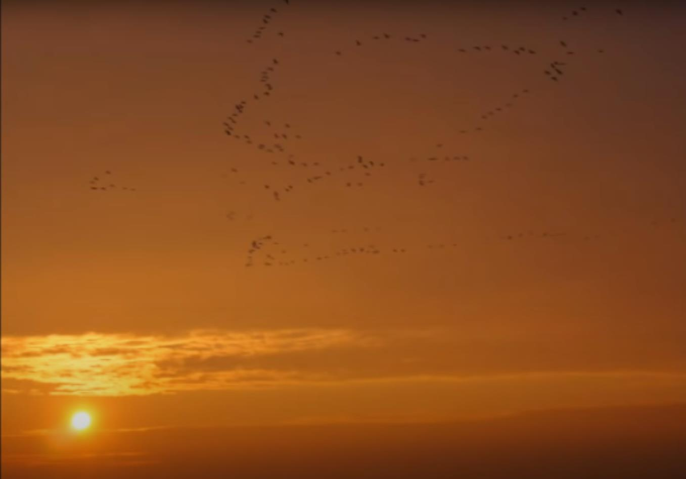
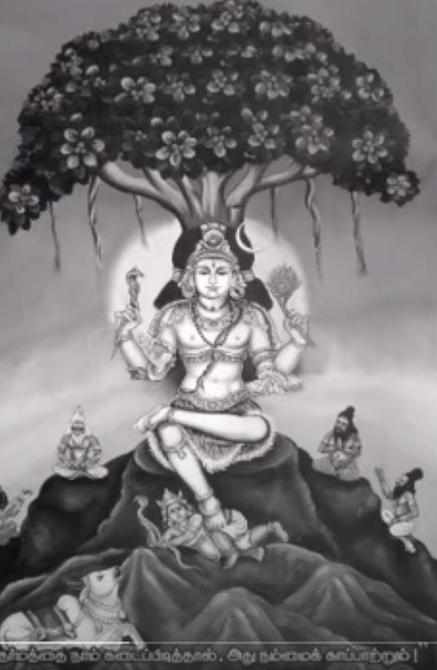
Dhakshinamoorthy Stotram
By
Swami Adi Sankara Acharya
Jnana Yoga sessions
2023 – ’24
NHHT Study Group

Slide 2
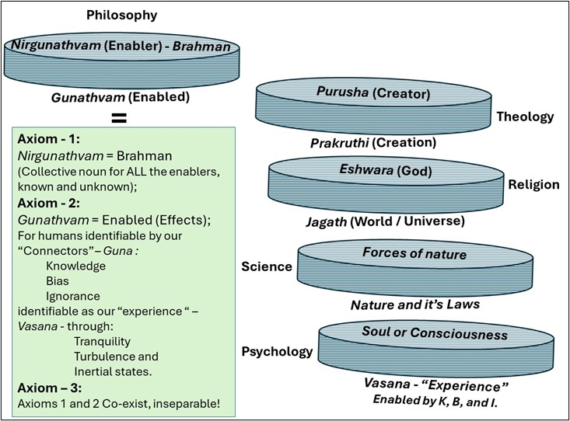
Introduction:
After several years of studies of various
Vedic scriptures, we have arrived at this
Simple summary of Vedic Philosophy.
This Philosophy can be interpreted and applied under many domains such as Theology, Religion, Science, Psychology, etc.
The brilliance of Adi Sankara is that he provides a basic frame work for the Vedic Philosophy. Then he extends the same in terms suitable for theologians. He also provides an extension of the same to Hindu religious practices, well known as the path of Advaita.
In the Dakshinamurthi Stotram, we find this brilliant interplay of Philosophy and Theology articulated by Swami Adi Shankaracharya.
In the following, one can read this interpretation / understanding by the Jnana Yoga group from the studies in the past two years!
Hari Om!
Dr. Krishnamoorthy (Subbu) Subramanian
Vedic Philosophy may be summarized as three Axioms
(Self evident truths)

Slide 3
• Dhakshinamurti – South facing Deity Teaching Brahma Vidya.
  • A form given to Brahman for worship and meditation.
• Dhakshina Amurti - Expert in communicating the essence
of formless Nirguna Brahman.
Adhi Sankara has written very many great Stotra (prayer songs).
Dakshinamurthi Stotram is a unique prayer, a summary of all the Vedic philosophy that he has taught.
Even during his time, this Stotra was difficult to comprehend.
One of his disciples, Sureshwaracharya, wrote a commentary called Manasollasa to this Stotra.
There are a large number of books and commentaries on this commentary itself!
https://www.youtube.com/watch?v=F-l94K5XLK8
Dakshinamurthi Slokam with English Translation:
https://www.youtube.com/watch?v=fPoP7Kk7vgU
Adi Sankara – Brahma Jnana Stotram:
https://www.youtube.com/watch?v=HzKKjBFcrgQ

Slide 4
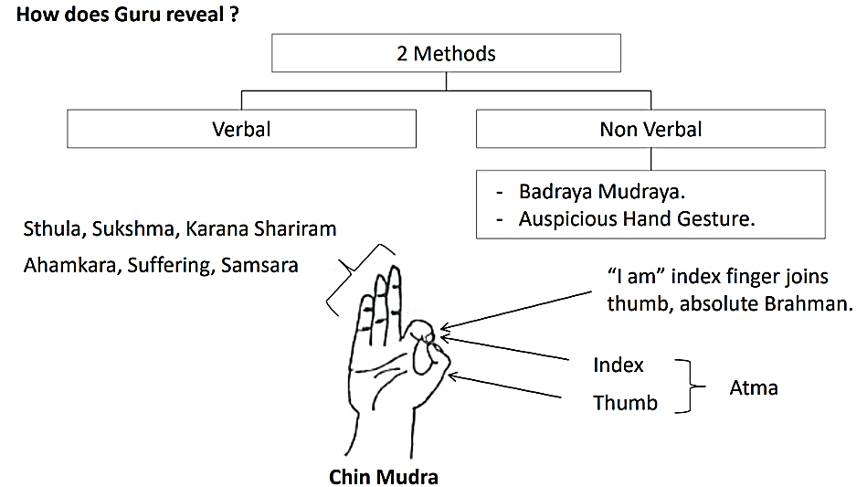
Dhyana Sloka (Invocation)
That supreme truth or Brahman appeared in silence in a youthful form; Surrounded by wise sages with their mind focused on Brahman.
The blissful form of Chin-Mudra seen in the folded palm of the Great Teacher reflects that Brahman, that He reveals with a joyful expression.
I offer my prayers to that Lord Dhakshinamoorthy 1
मौनव्याख्या प्रकटित परब्रह्मतत्त्वं युवानं वर्षिष्ठांते वसद् ऋषिगणैः
आवृतं ब्रह्मनिष्ठैः ।
आचार्येन्द्रं करकलित चिन्मुद्रमानंदमूर्तिं
स्वात्मारामं मुदितवदनं दक्षिणामूर्तिमीडे ॥१॥
Mauna-Vyaakhyaa Prakattita
Para-Brahma-Tattvam Yuvaanam
Varssisstthaam-Te Vasad Rssigannauh Aavrtam Brahma-Nisstthaih |
Aacaarye[a-I]ndram Kara-Kalita
Cin-Mudram-Aananda-Muurtim
Sva-[A]atmaaraamam Mudita-Vadanam Dakssinnaamuurti-Miidde ||1||
Chin-Mudra:
The folded palm of the Great Teacher reflects the entirety of Vedic Philosophy :
Index finger: Individual Consciousness / Athma
Thumb: Universal Consciousness / Brahman
These two fingers when united represent our ability to step away and reflect on
the other three fingers - all that is “Cognitive” – that a human mind can relate to such as our physical body, its subtle functions, and the intellect (ability to feel the emotions and reasoning)
This stepping away for reflection (Yoga), exists together with the “enablers” – Athman/Brahman!

Slide 5
वटविटपि समीपे भूमिभागे निषण्णं
सकलमुनिजनानां ज्ञानदातारमारात् ।
त्रिभुवनगुरुमीशं दक्षिणामूर्तिदेवं
जननमरणदुःखच्छेद दक्षं नमामि ॥२॥
Vatta-Vittapi-Samiipe-Bhuumi-Bhaage Nissannnnam
Sakala-Muni-Janaanaam Jnyaana-Daataaram-Aaraat |
Tri-Bhuvana-Gurum-Iisham Dakssinnaamuurti-Devam
Janana-Maranna-Duhkhac-Cheda Dakssam Namaami ||2||
Near the Banyan tree, are sages and seekers of the Truth, seated on the ground by the side of the one – Brahman - who gives the wisdom. He is the teacher of the three worlds.
He is the wise one who breaks the cycle of birth / death, sorrow and change …
I bow to him, Lord Dakshinamurthi. 2
 | Three “World” represented by the three fingers in “Chin Mudra”
Universe | Earth | Space | Cosmos
Time | Past (Before) | Present (Now) | Future
Human | Physical / Living | Subjective (Emotional) / Objective | Integral part of nature
Connectors (Guna) | Knowledge | Bias | Ignorance
Experience | Tranquil | Turbulent | Inertial
Theological | Heaven | Earth | Hell
Awareness | Awake | Sleep / Dreaming | Deep sleep
Knowledge | Truth | unsure | Lie
Examples of the many dimensions we can relate to, and three components or aspects in each.
Om or Brahman transcends all these.
One who transcends past the three components in each dimension, sees life and death as merely the course of events of nature, just as the corn plant germinates, yield more corn and perishes!
From that perspective duality (happiness/sorrow, change/constant, etc.)
also cease to exist!

Slide 6
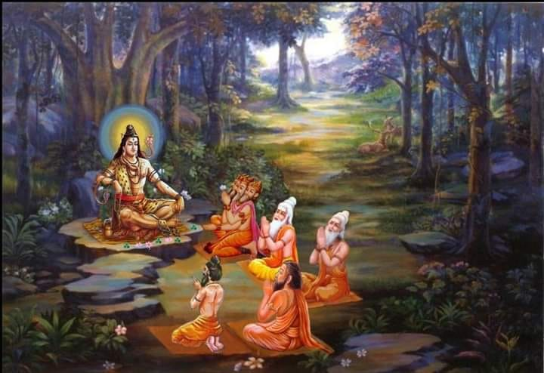
चित्रं वटतरोर्मूले
वृद्धाः शिष्या गुरुर्युवा ।
गुरोस्तु मौनं व्याख्यानं
शिष्यास्तुच्छिन्नसंशयाः ॥३॥
Citram Vatta-Taror-Muule
Vrddhaah Shissyaa Gurur-Yuvaa |
Guros-Tu Maunam Vyaakhyaanam
Shissyaas-Tuc-Chinna-Samshayaah ||3||
Picturesque indeed is the sight at the root of the Banyan tree, where the aged disciples and the young guru are seated;
The teacher’s silent explanations
removed all the doubts of the disciples. 3
The teacher’s silent explanations:
Knowledge of Brahman
https://www.youtube.com/watch?v=uDr1S4jvylk

Slide 7




निधये सर्वविद्यानां
भिषजे भवरोगिणाम् ।
गुरवे सर्वलोकानां
दक्षिणामूर्तये नमः ॥४॥
Nidhaye Sarva-Vidyaanaam
Bhissaje Bhava-Roginnaam |
Gurave Sarva-Lokaanaam
Dakssinnaamuurtaye Namah ||4||
The treasure trove of all knowledge, the healer of diseases of the body and mind, teacher for the entire world,
I bow to that Lord Dakshinamurthi. 4
Note: Knowledge of Brahman is the treasure trove of all knowledge!
Such knowledge fosters the healing required for:
Body: Physical health --Material /living;
Mind: Emotional health – Psychology; and
Intellect (Thoughts): Intellectual health – Spiritual / Philosophy
ॐ नमः प्रणवार्थाय
शुद्धज्ञानैकमूर्तये ।
निर्मलाय प्रशान्ताय
दक्षिणामूर्तये नमः ॥५॥
Om Namah Prannava-Arthaaya
Shuddha-Jnyaanai[a-E]ka-Muurtaye |
Nirmalaaya Prashaantaaya
Dakssinnaamuurtaye Namah ||5||
I bow to the meaning of the primal word, Aum, embodiment of untainted knowledge; ever pure, tranquil.
I bow to that Lord Dakshinamurthi. 5
Om is a composite of three sounds and hence three letters A, U, M
These three letters in Sanskrit, in their combination can be
visualized to represent the entirety of Vedic Philosophy?
Om can be visualized similar to Chin Mudra?
Part of A: Represents the all that is cognitive (in three dimensions)
Part of U: Represents “Yoga” or our self control for objectivity and non-attachment (looking away from and into the Cognitive)
Part of M: Brahman, that which enables and hence completes the OM, yet is not connected with the cognitive permanently!
=
+
+
=
A
+
U
+
M
AUM is everything; AUM is Brahman
Mandukya Upanishad

Slide 8






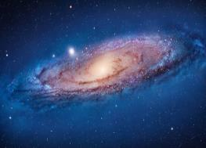


चिद्घनाय महेशाय
वटमूलनिवासिने ।
सच्चिदानन्दरूपाय
दक्षिणामूर्तये नमः ॥६॥
Cid-Ghanaaya Mahe[aa-Ii]shaaya
Vatta-Muula-Nivaasine |
Sac-Cid-Aananda-Ruupaaya
Dakssinnaamuurtaye Namah ||6||
Pure consciousness – Brahman – is the great Lord,
that dwells at the root of all that grows / emanates in the form of “existence – awareness – bliss”,
I bow to that Lord Dakshinamurthi. 6*
Brahman, Is seen in the forms of Eshwar, Guru and Athma. Its expansive form is like the sky or space - all pervading in the universe,
I bow to that Lord Dakshinamurthi. 7 / 6
ईश्वरो गुरुरात्मेति
मूर्तिभेदविभागिने ।
व्योमवद् व्याप्तदेहाय
दक्षिणामूर्तये नमः ॥७॥
Iishvaro Gurur-Aatme[a-I]ti
Muurti-Bheda-Vibhaagine |
Vyoma-Vad Vyaapta-Dehaaya
Dakssinnaamuurtaye Namah ||7||
Material Objects
Activities
DNA
(Life processes)
MEAL
Mine

Slide 9
Prayer Verses (Mantra Slokam):
Like the sights of a city are reflected In a mirror, the images of the world are seen reflected in Him (Consciousness / Brahman) due to Maya (Illusion);
While asleep, living beings appear to be outside of Him; After waking up one realizes that duality on one’s own accord
I bow down to that image of Sri Guru within, Sri Dakshinamurthi. 1
विश्वं दर्पणदृश्यमाननगरीतुल्यं
निजान्तर्गतंपश्यन्नात्मनि मायया
बहिरिवोद्भूतं यथा निद्रया ।
यः साक्षात्कुरुते प्रबोधसमये
स्वात्मानमेवाद्वयं तस्मै
श्रीगुरुमूर्तये नम इदं
श्रीदक्षिणामूर्तये ॥१॥
Vishvam Darpanna-Drshyamaana-Nagarii-Tulyam
Nija-Antargatam Pashyann-Aatmani Maayayaa
Bahir-Ivo[a-U]dbhuutam Yathaa Nidrayaa |
Yah Saakssaat-Kurute Prabodha-Samaye
Sva-[A]atmaanam-Eva-Advayam Tasmai
Shrii-Guru-Muurtaye Nama Idam
Shrii-Dakssinnaamuurtaye ||1||
Enabler
Enabled
Enabler
Enabled
Maya - Illusion
Reality
बीजस्याऽन्तरिवाङ्कुरो जगदिदं
प्राङ्गनिर्विकल्पं पुनः मायाकल्पितदेशकालकलना
वैचित्र्यचित्रीकृतम् ।
मायावीव विजृम्भयत्यपि
महायोगीव यः स्वेच्छया
तस्मै श्रीगुरुमूर्तये नम इदं
श्रीदक्षिणामूर्तये ॥२॥
Biijasya-Antar-Iva-Angkuro Jagad[t]-Idam Praangga-Nirvikalpam Punah Maayaa-Kalpita-Desha-Kaala-Kalanaa Vaicitrya-Citrii-Krtam |
Maayaavi-Iva Vijrmbhayaty-Api Mahaa-Yogi-Iva Yah Sve[a-I]cchayaa
Tasmai Shrii-Guru-Muurtaye Nama Idam Shrii Dakssinnaamuurtaye ||2||
Like the sprout inside is part of the seed,
the world is part of the whole reality (Brahman)
before becoming manifest.
Due to illusion of time and space, the amazingly splendid world is caused.
Like a magician’s great act, the Great Yogi
(Brahman) does this on His own free will.
I bow down to that image of Sri Guru within, Sri Dakshinamurthi 2
Brahman (Great Yogi), creates the Universe of His Free Will: Brahman exists, enabling the Universe to exist!

Slide 10
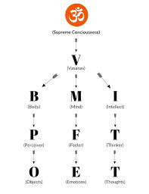
Yasya-Eva Sphurannam Sada[a-A]atmakam-Asat-Kalpa-Arthakam Bhaasate Saakssaat-Tat-Tvam-Asi-Iti Veda-Vacasaa
Yo Bodhayaty-Aashritaan |
Yat-Saakssaat-Karannaad-Bhaven-Na Punaraavrttir-Bhavaam-Bho-Nidhau
Tasmai Shrii-Guru-Muurtaye Nama Idam Shrii-Dakssinnaamuurtaye
The great silence in heart (Universal Consciousness – Brahman - ) is the cause of the throbbing source of the world.
It is seen mistakenly as an unreal existence.
In reality, “Tat Thwam Asi” – Thou art that – the veda Maha Vakya, enlightens those who realize it. That direct vision breaks the cycle of birth and death.
I bow down to that image of Sri Guru within, Sri Dakshinamurthi 3
यस्यैव स्फुरणं सदात्मकम सत्कल्पार्थकं भासते साक्षात्तत्त्वमसीति
वेदवचसा यो बोधयत्याश्रितान् ।
यत्साक्षात्करणाद्भवेन्न पुनरावृत्तिर्भवाम्भोनिधौ तस्मै श्रीगुरुमूर्तये नम इदं
श्रीदक्षिणामूर्तये ॥३॥
Enabler / Driver
Universal Consciousness
5
Subtle
Soul or Consciousness
Five Layers
Pancha Kosha
All Maha Vakya refer to the same meaning; Understanding any of them breaks the cycle of birth and death.
Tat Thwam Asi
Aham Brahma
Sarvam Brahma Mayam
Enabled / Driven
Self-control
Impulsive
5
Soul /
Consciousness
Tangible
4
Objective
Subjective
3
Mind
4
Analytical /
Reflective
Non-attachment
Attachment
Body
Tranquility
Turbulence
Inertial
3
Emotional /
Impulsive
2
Knowledge
Bias
Ignorance
Universe
2
Living /
Person
1
Thinking
Feeling
Perception
Thoughts
Emotions
Objects
1
Material/
Object
https://cmwrc.chinmayadc.org/portfolio/bmichart/
World of Activities

Slide 11


Vedic Philosophy
Mind over Matter
Our Perceptions (what we see, hear, …), Emotions (feelings) and Thoughts, are all channeled and processed through our mind!
Looking from outside, observing this interaction of “mind over matter”, is YOGA!
Consciousness that enables this ability to see objects, feel the emotions, think of thoughts and our ability to look from outside is Brahman: Pragjnanam Brahma.
Picture on the left:
We see a woman practicing Yoga at her home.
We think that her mind is focused on Yoga practice.
We believe that the dog is sleeping peacefully ,
free from all that is happening around,.
Plants are also in this space, growing in the direction of sunlight.
Our “mind” – the observer, mind of the woman, dog - all have their own perception, feelings and thoughts!
Plants too have their own “perception” of sun light!
Picture on the right:
Our eyes see the picture inside a TV set.
Our perception, emotions and thoughts
change instantly!
The Consciousness in us, the woman, the dog, the plants, …. collectively known as Brahman!

Slide 12
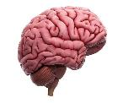
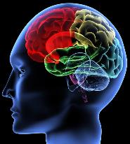
Self-control / Reflection: Conscience = Connector Science!
Consciousness
Personality aspects | Role of Dominant Connector
 | Knowledge | Bias | Ignorance
Resilience | High | Variable | Low
Acceptance | High | Variable | Low
Appreciation | High | Variable | Low
Prevention | Open to suggestions | Follow up varies with time and mood | Not Interested
Self-compassion | High | Comparison as a way to focus on the self | Absent leading to Self-pity
Barriers | Aware | Over or under estimation | Unaware
Gratitude (Awe) | Respectful | Reward seen as return of favor | Unaware
Savoring | Glass Half Full | Glass Half Empty | Nothing to savor
Acknowledgement | Smell the roses | Could have a better rose! | Thorns are bothering me!
Driver
Driven
Mine
Body
Mind
Intellect
Connectors (K, B and I) always Co-exist
Dominance of one over the other two determines our experience (Tranquility, Turbulence or Inertia)
Minimize B and I; Knowledge will grow to fill the void
Ignorance can not be replaced by Knowledge directly. It requires sustained action (or Bias)!

Slide 13
नानाच्छिद्रघटोदरस्थित
महादीप प्रभा भास्वरं
ज्ञानं यस्य तु
चक्षुरादिकरणद्वारा
वहिः स्पन्दते ।
जानामीति तमेव भान्त
मनुभात्येतत्समस्तं जगत्
तस्मै श्रीगुरुमूर्तये नम
इदं श्रीदक्षिणामूर्तये ॥४॥
देहं प्राणमपीन्द्रियाण्यपि चलां
बुद्धिं च शून्यं विदुः
स्त्रीबालान्धजडोपमास्त्वहमिति
भ्रान्ता भृशं वादिनः ।
मायाशक्तिविलासकल्पित
महाव्यामोहसंहारिणे
तस्मै श्रीगुरुमूर्तये नम
इदं श्रीदक्षिणामूर्तये ॥५॥
Naanaac-Chidra-Ghatto[a-U]dara-Sthita-Mahaa-Diipa-Prabhaa Bhaasvaram
Jnyaanam Yasya Tu Cakssur-Aadi-Karanna-Dvaaraa Vahih Spandate |
Jaanaam-Iiti Tam-Eva Bhaantam-Anubhaaty-Etat-Samastam Jagat
Tasmai Shrii-Guru-Muurtaye Nama Idam Shrii-Dakssinnaamuurtaye ||4||
Light emanating from a great lamp inside a pot
with many holes spreads light in all directions;
Wisdom that emanates through the sense
organs is the cause of throbbing enlightenment.
One who realizes “I know myself”, will realize that “
He” alone shines and everything else is this Jagat
(i.e.) “world”. Ekam Sathyam; Jagat Mitya .
I bow down to that image of Sri Guru within,
Sri Dakshinamurthi 4
Some scholars think that our body, breathing, sense organs, earth, mind and the space are the real and the truth. Are they not like the intense but naive arguments of the blind, innocent girls and children? That confusion, the great power play of thy maya or illusion can be eliminated only by thee (i.e.) Knowledge and understanding of Brahman – Universal Consciousness.
I bow down to that image of Sri Guru within,
Sri Dakshinamurthi 5
Deham Praannam-Api-Indriyaanny-Api Calaam Buddhim Ca Shuunyam Viduh Strii-Baala-Andha-Jaddo(a-U)pamaas-tv[u-]Aham-Iti Bhraantaa Bhrsham Vaadinah |
Maayaa-Shakti-Vilaasa-Kalpita-Mahaa-Vyaamoha-Samhaarinno
Tasmai Shrii-Guru-Muurtaye Nama Idam Shrii-Dakssinnaamuurtaye ||5||
Theology:
“He” – the Supreme Being alone shines and everything else is this Jagat (i.e.) “world”.
Science:
Our body, breathing, sense organs, earth, mind and the space are the only real and the truth.
Brahman:
That which enables …
Fire to Burn
Wind to move
Sun to shine
Eyes to blink
Planets to revolve
Universe to exist
…..
Vedic Philosophy:
Universe is enabled by infinite driving forces of nature, known and Un-known. All such forces – enablers - are identified by a singular noun: Brahman.
Spirituality :
Understanding our connection
with the “Spirit” or the driving force!
Based on Faith,
God as the judge or standard;
Divinity as a reference or
Standard for objectivity
Theology
Based on
“Laws of Nature”
Inferred through Objective analysis of data and conclusion.
Science

Slide 14
राहुग्रस्तदिवाकरेन्दुसदृशो
मायासमाच्छादनात्
सन्मात्रः करणोपसंहरणतो
योऽभूत्सुषुप्तः पुमान् ।
प्रागस्वाप्समिति प्रबोधसमये यः
प्रत्यभिज्ञायते
तस्मै श्रीगुरुमूर्तये नम इदं
श्रीदक्षिणामूर्तये ॥६॥
बाल्यादिष्वपि जाग्रदादिषु तथा
सर्वास्ववस्थास्वपि
व्यावृत्तास्वनुवर्तमानमहमित्यन्तः
स्फुरन्तं सदा ।
स्वात्मानं प्रकटीकरोति भजतां
यो मुद्रयाभद्रया
तस्मै श्रीगुरुमूर्तये नम इदं
श्रीदक्षिणामूर्तये ॥७॥
Raahu-Grasta-Divaakare[a-I]ndu-Sadrsho Maayaa-Sama-[A]acchaadanaat
San-Maatrah Karanno[a-U]pasangharannato Yo(a-A]bhuut-Sussuptah Pumaan |
Praag-Asvaapsam-Iti Prabodha-Samaye Yah Pratyabhijnyaayate
Tasmai Shrii-Guru-Muurtaye Nama Idam Shrii-Dakssinnaamuurtaye ||6||
Sun, while it continues to shine, it is covered by another planet (Rahu) during eclipse;
You (Brahman) are overshadowed by your own Maya.
This is like that man whose senses are suppressed when asleep, realizes that he was sleeping, when he wakes up from his dream!
I bow down to that image of Sri Guru within, Sri Dakshinamurthi 6
During the changing stages of the body (Childhood, youth, old age) and the mind (Awake, sleeping and dreaming), You (Brahman) always remain changeless;
you reveal the greatest knowledge, shining forever to those who progress in their worship, you reveal thy blissful chin-mudra.
I bow down to that image of Sri Guru within, Sri Dakshinamurthi 7
Baalya-Adissv(u)-Api Jaagrad-Aadissu Tathaa Sarvaasv[u]-Avasthaasv[u]-Api
Vyaavrttaasv[u]-Anu-Vartamaanam-Aham-Ity[i]-Antah Sphurantam Sadaa |
Sva-[A]atmaanam Prakattii-Karoti Bhajataam Yo Mudrayaa-Bhadrayaa
Tasmai Shrii-Guru-Muurtaye Nama Idam Shrii-Dakssinnaamuurtaye ||7||
Tat Brahma Nishkalam Aham NaCha Bhuta SangaH:
I am that blemishless Brahman, not the individual identified with my body and its organs!
- Adi Sankaracharya.

Slide 15
The world / people see everything as cause and effect, thinks only of difference between us and the Lord, the student and the teacher, the father and the son. etc.
Unable to see the difference between dream and being awake, man is confused by the power of Maya.
I bow down to that image of Sri Guru within, Sri Dakshinamurthi 8
The Lord appears in eight forms as moving and unmoving universe consisting of: the Earth, Water, Fire, Air, Ether, the sun, moon and the individual soul. He has manifested on his own in eight images. There is nothing you can search for, as the Lord is everywhere, the all pervading.
I bow down to that image of Sri Guru within, Sri Dakshinamurthi 9
विश्वं पश्यति कार्यकारणतया
स्वस्वामिसम्बन्धतः
शिष्याचार्यतया तथैव
पितृपुत्राद्यात्मना भेदतः ।
स्वप्ने जाग्रति वा य एष पुरुषो
मायापरिभ्रामितः
तस्मै श्रीगुरुमूर्तये नम
इदं श्रीदक्षिणामूर्तये ॥८॥
भूरम्भांस्यनलोऽनिलोऽम्बरमहर्नाथो
हिमांशु पुमान्
इत्याभाति चराचरात्मकमिदं
यस्यैव मूर्त्यष्टकम्
नान्यत् किञ्चन विद्यते विमृशतां
यस्मात्परस्माद्विभोः
तस्मै श्रीगुरुमूर्तये नम
इदं श्रीदक्षिणामूर्तये ॥९॥
Vishvam Pashyati Kaarya-Kaaranna-Tayaa Svasvaami-Sambandhatah
Shissya-[A]acaarya-Tayaa Tatha-Eva Pitr-Putraady[i]-Aatmanaa Bhedatah |
Svapne Jaagrati Vaa Ya Essa Purusso Maayaa-Paribhraamitah
Tasmai Shrii-Guru-Muurtaye Nama Idam Shrii-Dakssinnaamuurtaye ||8||
Bhuur-Ambhaamsy-Analo-[A]nilo-[A]mbaram-Aharnaatho
Himaamshu Pumaan
Ity[i]-Aabhaati Cara-Acara-[A]atmakam-Idam Yasya-Eva Muurty[i]-Assttakam
Naanyat Kin.cana Vidyate Vimrshataam Yasmaat-Parasmaad-Vibhoh
Tasmai Shrii-Guru-Muurtaye Nama Idam Shrii-Dakssinnaamuurtaye ||9||

Slide 16




Brahman
Wise people speak of the indestructible Aswaththa Tree: Peepul Tree (Ficus Religiosa) with its roots above and branches below, whose leaves are the Vedas; one who knows it is the wise one, with the knowledge of the Vedas (Veda Vit). B.G. 15.1.
Consciousness, Soul,
Spirit, SELF (Athma)
Dehinam
?
?
Tranquil
Turbulent
Inertial
YOGA
(Self-control)
Subjective Vs. Objective
Experience
(Vasana)
I
K
B
B
I
B
I
K
K
(Sathvikam) (Rajasam) (Thamasam)
Deham
Connectors
(Guna)
Knowledge
Bias
Ignorance
Under the Banyon tree, on the ground are sages and seekers of the Truth, seated by the side of the one who gives the wisdom, teacher of the three worlds, Lord Dakshinamurthi, the wise one who breaks the cycle of birth / death, sorrow and change … I bow to him
Dakshinamurhi Strotram 2
Body Mind Intellect
Perceive Feel Think
Objects Emotions Thoughts
Analogy:
Aswaththa Tree
(with roots are above and branches below)
World of Experiences
(Samsara Sagaram)

Slide 17
सर्वात्मत्वमिति स्फुटीकृतमिदं
यस्मादमुष्मिन् स्तवे
तेनास्य श्रवणात्तदर्थमननाद्ध्यानाच्च
संकीर्तनात् ।
सर्वात्मत्वमहाविभूतिसहितं
स्यादीश्वरत्वं स्वतः
सिद्ध्येत्तत्पुनरष्टधा परिणतं
चैश्वर्यमव्याहतम् ॥१०॥
Sarva-[A]atmatvam-Iti Sphuttii-Krtam-Idam Yasmaad-Amussmin Stave
Tena-Asya Shravannaat-Tadartha-Mananaad-Dhyaanaac-Ca Sangkiirtanaat |
Sarva-(A)atmatva-Mahaa-Vibhuuti-Sahitam Syaad-Iishvaratvam Svatah
Siddhyet-Tat-Punar-Assttadhaa Parinnatam
Ca-[A]ishvaryam-Avyaahatam ||10||
Hearing of the shining universal soul that unifies all as explained in this hymn; Reflecting on its meaning, chanting aloud as a meditative Sankeertan (Prayer song) one will achieve Sarva Athma Bhava (at home with all souls or the universe at large), the Universal Consciousness, the greatest treasure of Self-realization; acquire eight Siddhis without any obstacles and gain auspiciousness. 10.
Spirituality: Seeing everyone in the “self” and also seeing the “self” in everyone!
॥ iti śrīmath Saṅkarāchāryavirachitaṃ dakṣiṇāmurtistōtraṃ sampūrṇam ॥
Thus ends the Dakshinamurthi Stotram composed by Saint Adi Sankara
https://www.youtube.com/watch?v=fPoP7Kk7vgU&list=RD6oIrgLehqKA&index=5
https://vedantastudents.com/wp-content/uploads/2018/10/01-Dakshinamurthy-Stotram.pdf
Aum Tat Sath Brahmarpanam Astu:
May all our activities be dedicated to Total Self-control and Un-attached active engagement!
https://www.youtube.com/watch?v=cqPlGaHQUNQ
Morning Meditation on Brahman - Shankara's Pratas Smarana Stotram
https://www.youtube.com/watch?v=lw5jdQSYKac
Shankaracharya's Historic Debate with Mandan Mishra
https://www.youtube.com/watch?v=77KnJrk3UWI
Jagadguru Adi Shankara Scenes - Argument Between Shankara And Maṇḍana Miśra

Slide 18
All aspects of the cognitive world emerge from Him. (Consciousness / Brahman)
It is the Veda Maha Vakya: “Tat Twam Asi” – Thou art that
To believe the reflections or images (enabled) as real is illusion. Few Examples:
  Mirror reflects the images of a city. Reflected image is not the city, the enabler!
  When we wake up, we realize the same person who was asleep earlier.
  Sprout emerges enabled by the seed.
  Light emanating from a lamp inside a pot with many holes spreads the same light in all directions;
  Some scholars think that our body, breathing, sense organs, earth, mind and the space are the real and the truth. --- they are all enabled or illumined.
  Eclipse is the result of shadow a planet (Rahu) creates on the sun, which never becomes dark or switched off!
  Dreamer is the same person when he is awake. It is illusion to think otherwise!
He (Brahman) alone shines; everything else is Jagat (i.e.) “world”: enabled or illumined!. Perceptions of time and space (ability to think) create our illusion.
  The person is the same – as a child, young or old
  Dreamer, person awake or in deep sleep is one and the same.
  This cognitive ability in human is described as the magic act of the “Maha Yogi”.
images of the world are reflected in Him (Brahman or Lord).
One who fails to see this cause and effect, thinks the cause of the universe – Brahman - as unreal.
Wisdom emanating through sense organs is the source of enlightenment.
This vision breaks the cycle of life and death
There is nothing you can search for, as the Lord (Brahman) is everywhere, the all pervading.
Old students / Young teacher
Chin Mudra
Teacher of the three worlds
Breaks the cycle of Birth/death, sorrow and change
Silent explanation: Reflection and contemplation
Removes the doubts and ambiguity
Store house of all knowledge
Healer of all illness
Techer for the entire world
Brahman reflects the meaning of Om.
Symbolizes pure knowledge
Without blemish, bright or illuminating
Pure Consciousness; greatest Lord
One at the root or origin of everything
Represents Existence / awareness/ bliss.
The same undivided, all pervading – like the space –
Is seen differently as Eshwar, Guru, Athma.

